Slide 1
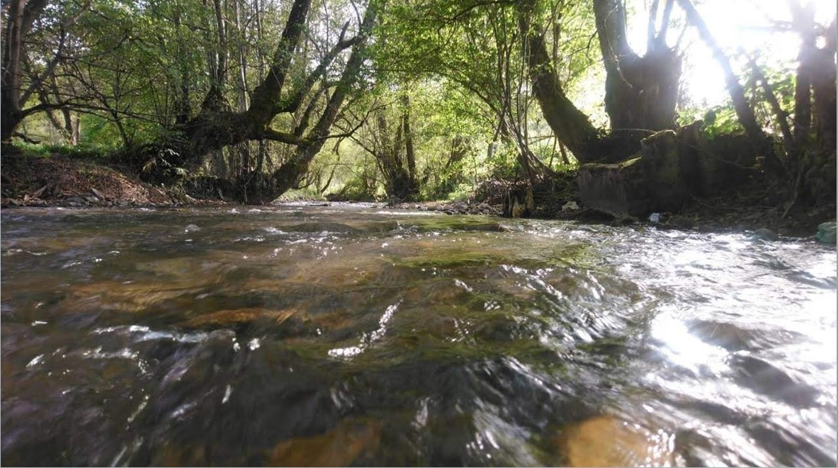
Erasmus+ project ECOBIAS
WP 5 DISSEMINATION
5.5. Round tables with stakeholders
Svjetlana Lolić
09.12.2022.

Slide 2
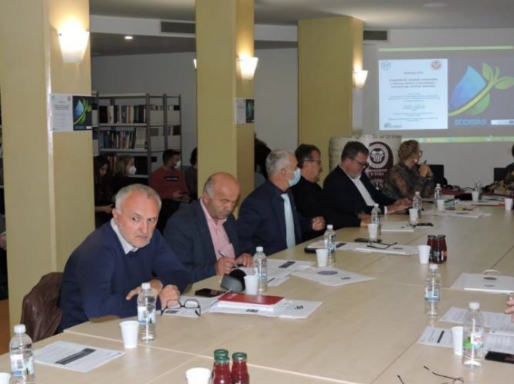
Round tables with stakeholders
The aim of round tables is primarily to create proactive strategy with stakeholders in the field of ecological monitoring and bioassessment
14 Round tables at PC HEIs
First round tables - 7 events: 06-15 of October, 2021.
Second round tables - 7 events: 22nd of May – 11th of June, 2022. (UDG: 4th of November, 2022.)

Slide 3
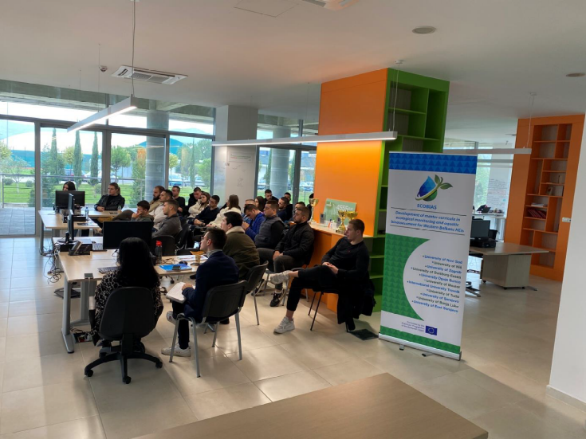
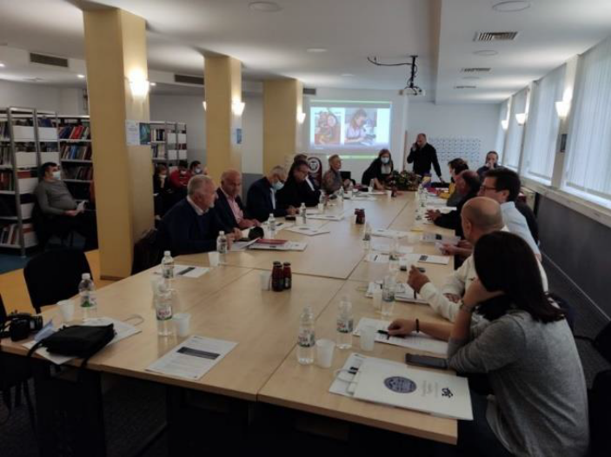
Round tables with stakeholders
target groups: stakeholders, public sector, local communities, NGOs, water quality testing laboratories, professors, students etc.
Total number of participants: 284

Slide 4
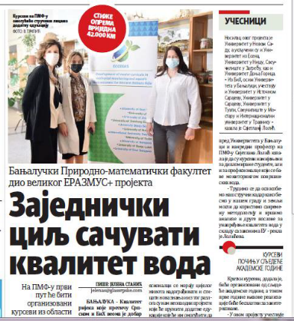
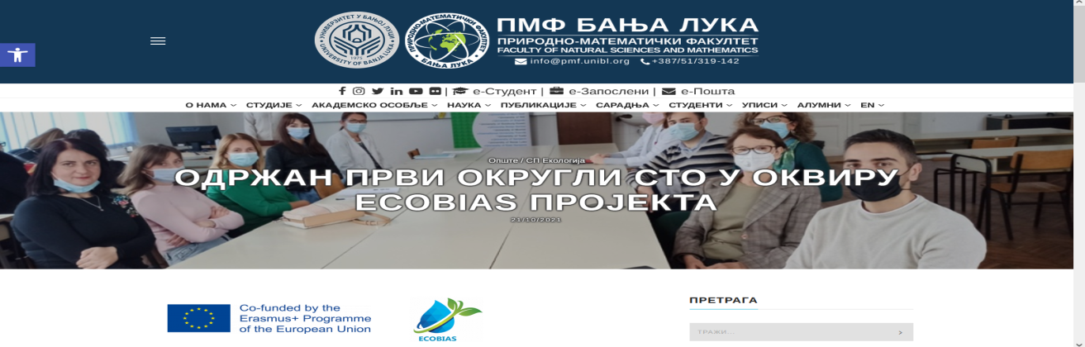
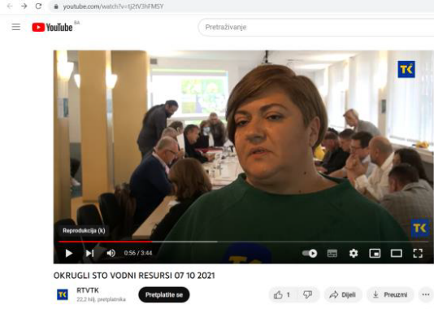
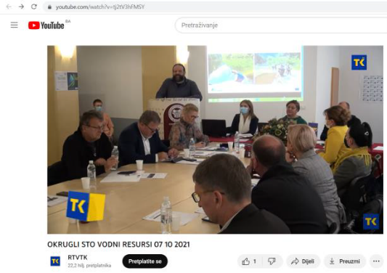
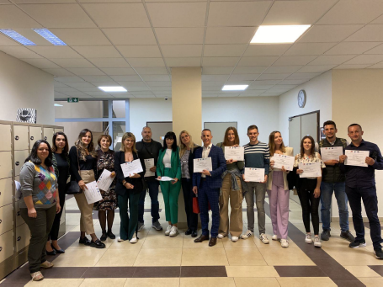
Round tables with stakeholders
Total visibility: number of posted articles: 49

Slide 5
Topics:
Enhancement of Cooperation Between HEIs and the Real Sector in the Field of Management and Monitoring of Aquatic Resources
Water management in the service of a sustainable future
Water monitoring in Republic of Srpska
Biomonitoring of water in FBIH
Importance of biodiversity in the field of biomonitoring
Biomonitoring and position of endemic aquatic species in Bosnia and Herzegovina
Shortcomings of existing water monitoring in Republic of Srpska

Slide 6
Topics:
Water karst ecosystems - state and perspectives
Challenges of waste disposal and preservation of aquatic ecosystems
The importance of education and environmental monitoring in water quality protection
Water quality monitoring, environmental protection and ecological education
Remediation of the Lašva riverbed in the urban zone of Travnik as a contribution to the planning of green areas
Development of master curricula in ecological monitoring and aquatic bioassessment for Western Balkans HEIs/ECOBIAS

Slide 7
issues related to biodiversity and biomonitoring in Bosnia and Herzegovina
IT solutions in ecological monitoring: necessity of creating a database in biodiversity research and creating the database of the biological indicator taxa for further application in ecological monitoring
shortcomings of existing legislation
strengthen cooperation between biologist and expert from public sector, stakeholders and nongovernmental organization

Slide 8
specific issues:
improvement the quality of Lake Modac and very polluted Spreča River, as well as Lašva riverbed
New ways of disposing of waste
Cyanotoxins in surface water
Potential dangers for the health of residents due to poor water quality were highlighted

Slide 9
Thank you for your attention

